Slide 1
Budgeting User Training
Client logo
Axiom Budgeting for Healthcare
October 2020

Slide 2
AGENDA
Getting Started
Budget Process Overview
Working with Budgets
Review and Submit
Publish Budget Plan Files
Wrap Up

Slide 3
Course Objectives
By the end of this class, you should be able to:
  Log in to Axiom Budgeting
  Complete each worksheet in your budget workbook
  Review and submit budget for approval

Slide 4
Getting Started
Lesson 1

Slide 5
Lesson 1 Objectives
By the end of this lesson, you should be able to:
  Log in to Axiom
  Understand the difference between Windows and Excel Client
  Open the Budget User Admin Task Pane
  Open, close, and save a budget plan file
  Navigate between worksheets in budget plan file
  Identify which cells can be changed – based on color coding

Slide 6
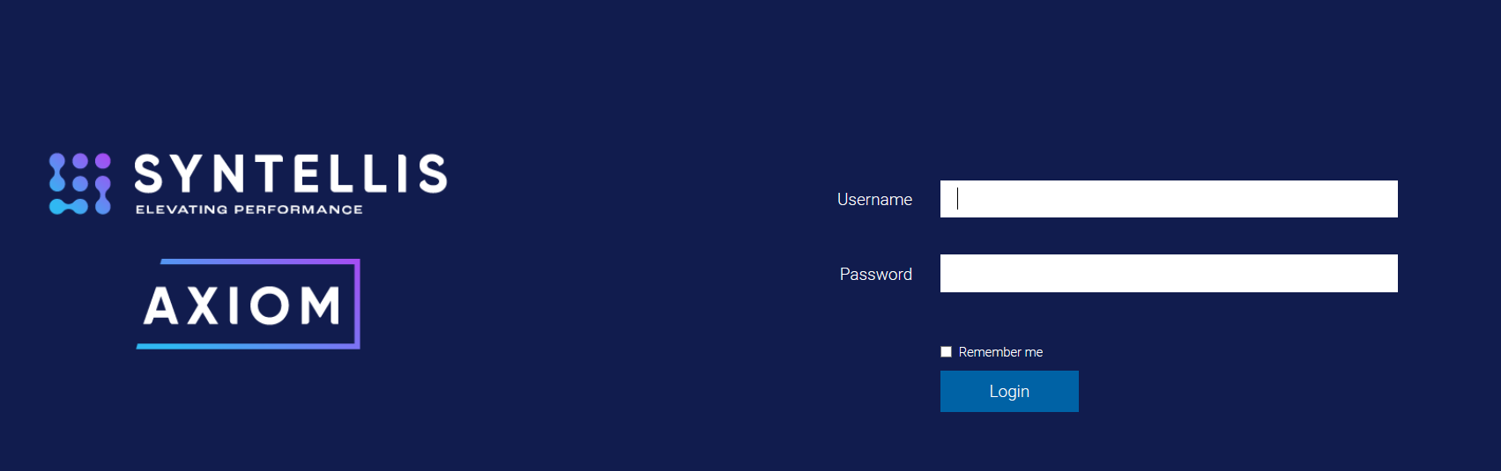
Lesson 1: Getting Started
Accessing Axiom

Slide 7
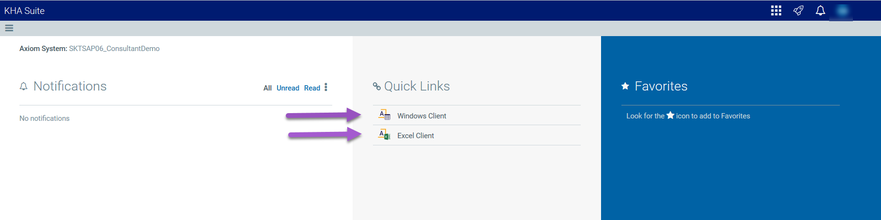
Lesson 1: Getting Started
Selecting Windows vs Excel Client

Slide 8
Lesson 1: Getting Started
Database
Spreadsheets
User

Slide 9
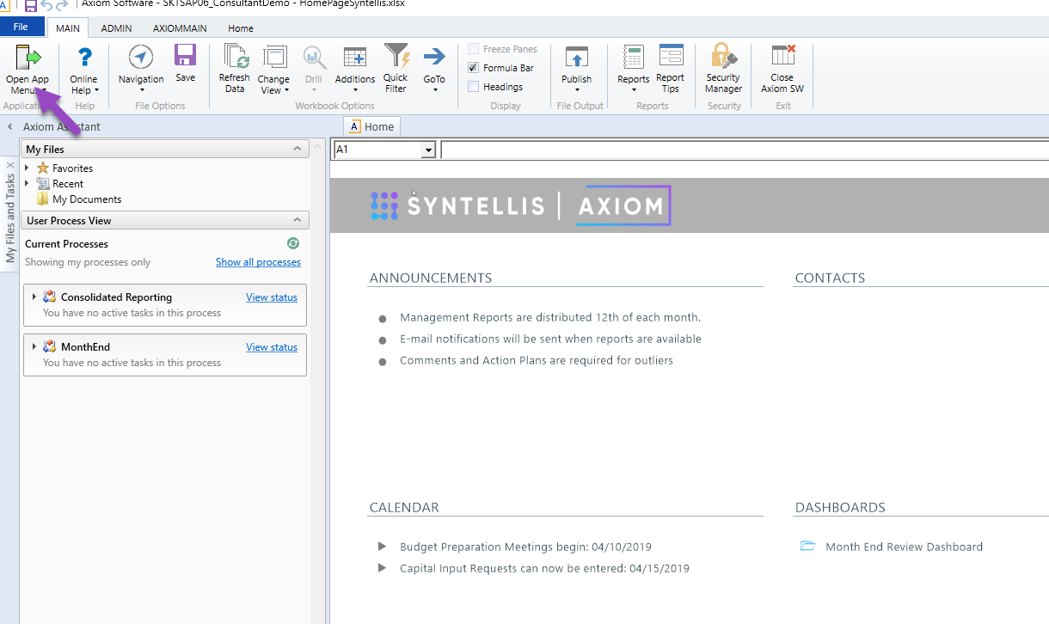
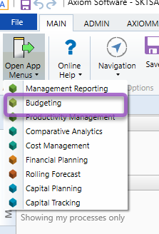
Lesson 1: Getting Started
Open Application Menu to select the “Budgeting” Task Pane

Slide 10
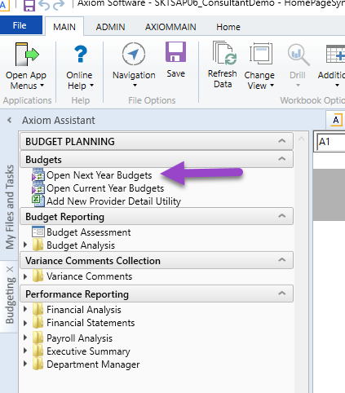
Lesson 1: Getting Started
Open Next Year Budget Plan Files from the “Budgeting” Task Pane
What is the difference between:
Next Year Budgets
Current Year Budgets

Slide 11
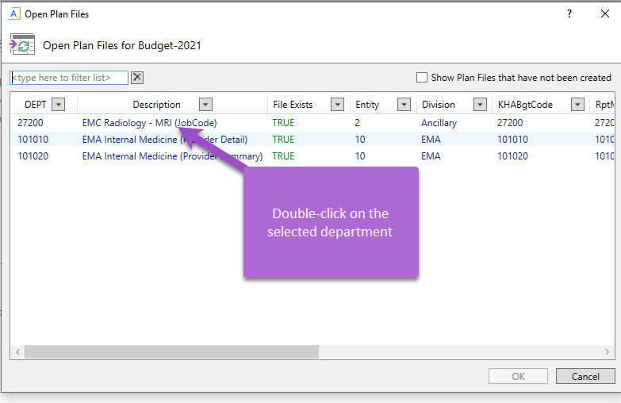
Lesson 1: Getting Started
Open selected Budget Plan File
Security allows you to only see the departments you are responsible to budget.

Slide 12
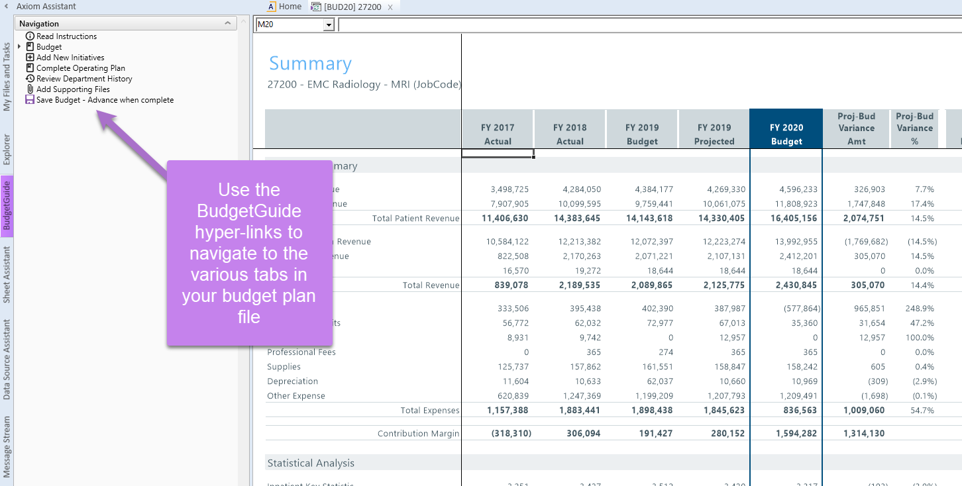
Lesson 1: Getting Started
Review “Budget Guide” Task Pane
The Budget Guide Task Pane steps are organized in the order that Syntellis considers “Best Practice” to complete your plan file.

Slide 13
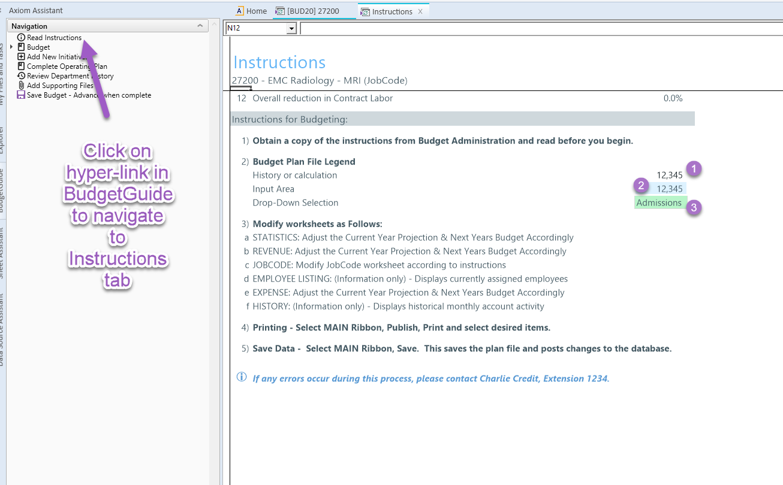
Lesson 1: Getting Started
Budget Plan File Legend
Cells in the Budget Plan File have three colors:
White – Protected Cells that can not be altered.
Blue – Cells where you can key in your work.
Green – A pick list to select your options.

Slide 14
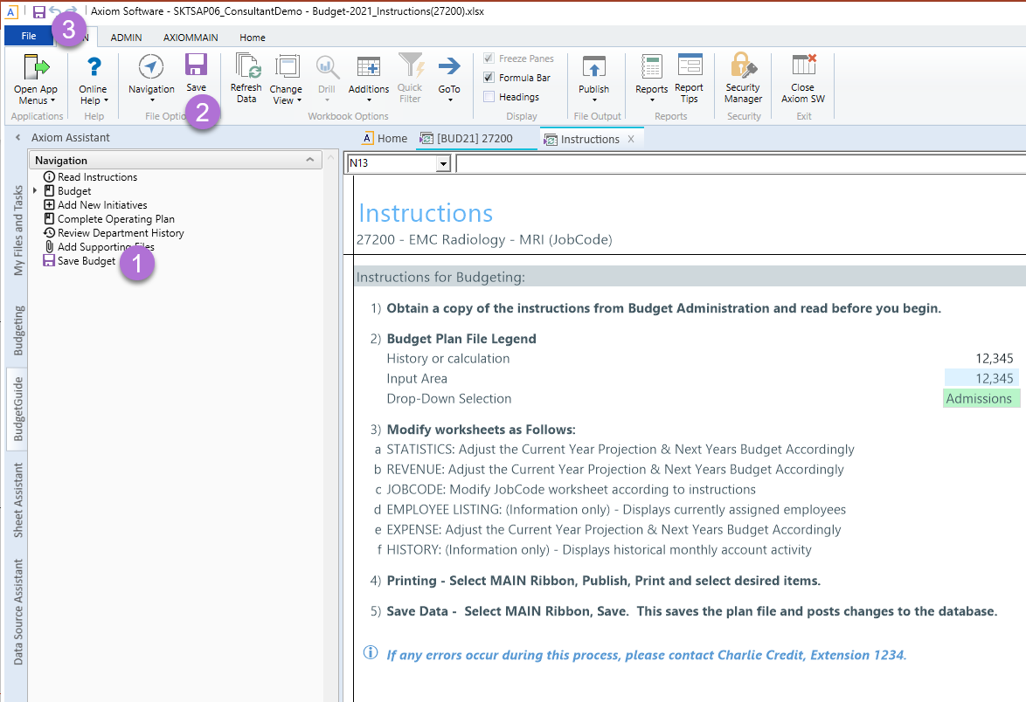
Lesson 1: Getting Started
Saving a Plan File
There are multiple options to save a plan file:
From the Budget Guide Task Pane
From the Main Menu Ribbon
From the Quick Access Toolbar

Slide 15
Lesson 1: Getting Started
Review Questions
What are the two access points into Axiom?
  Windows Client – must use for Plan Files
  Excel Client

Slide 16
Lesson 1: Getting Started
Review Questions
What task pane do you open to access your plan files?
  Budgeting

Slide 17
Lesson 1: Getting Started
Review Questions
What year are you accessing when you select the Next Year vs. the Current Year Budgets?
  Next Year
  Current Year

Slide 18
Lesson 1: Getting Started
Review Questions
How can you navigate between the tabs of the plan file?
  Budget Guide Task Pane
  Point and click

Slide 19
Lesson 1: Getting Started
Review Questions
What does it mean when a cell has:
  White shading
  Blue shading
  Green shading

Slide 20
Lesson 1: Getting Started
Recap
You should now be able to:
  Log in to Axiom
  Open the Budget Task Pane
  Identify which cells can be changed – based upon color coding
  Open, close, and save a budget plan file

Slide 21
Lesson 1: Getting Started

Slide 22
Budget Process Overview
Lesson 2

Slide 23
Lesson 2 Objectives
By the end of this lesson, you should be able to:
  Understand the purpose of each tab in a budget workbook
  Understand the time series that interface into the plan files
  Understand the Budget Methods assigned to a revenue or expense account

Slide 24

Lesson 2: Budget Process Overview
Budget Plan File tabs

Slide 25
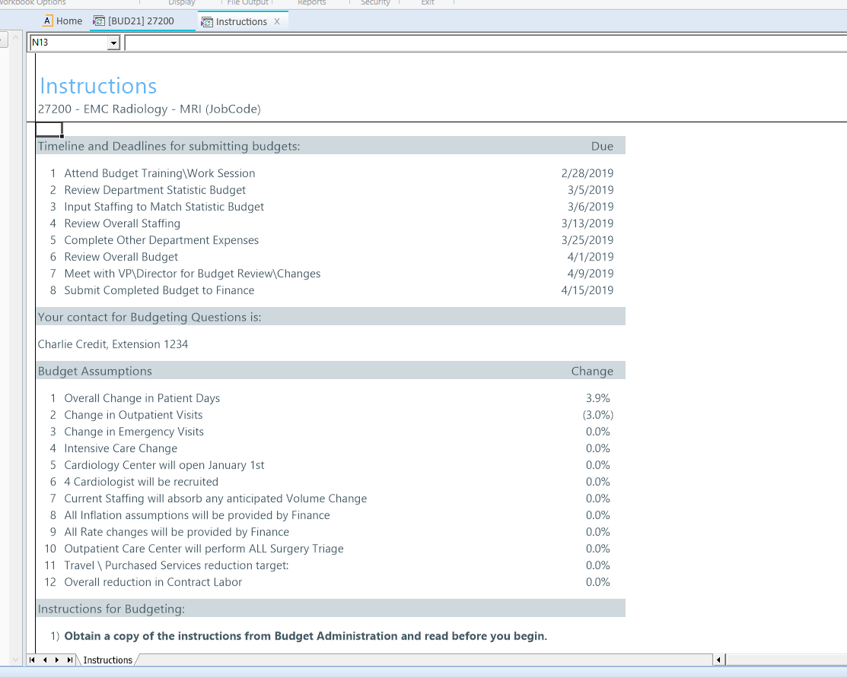
Lesson 2: Budget Process Overview
Instructions Tab
Instruction Tab:
  Populated based on dates and assumptions made by your Budget Administrator
  Information purposes only
  No work needs done on this tab

Slide 26
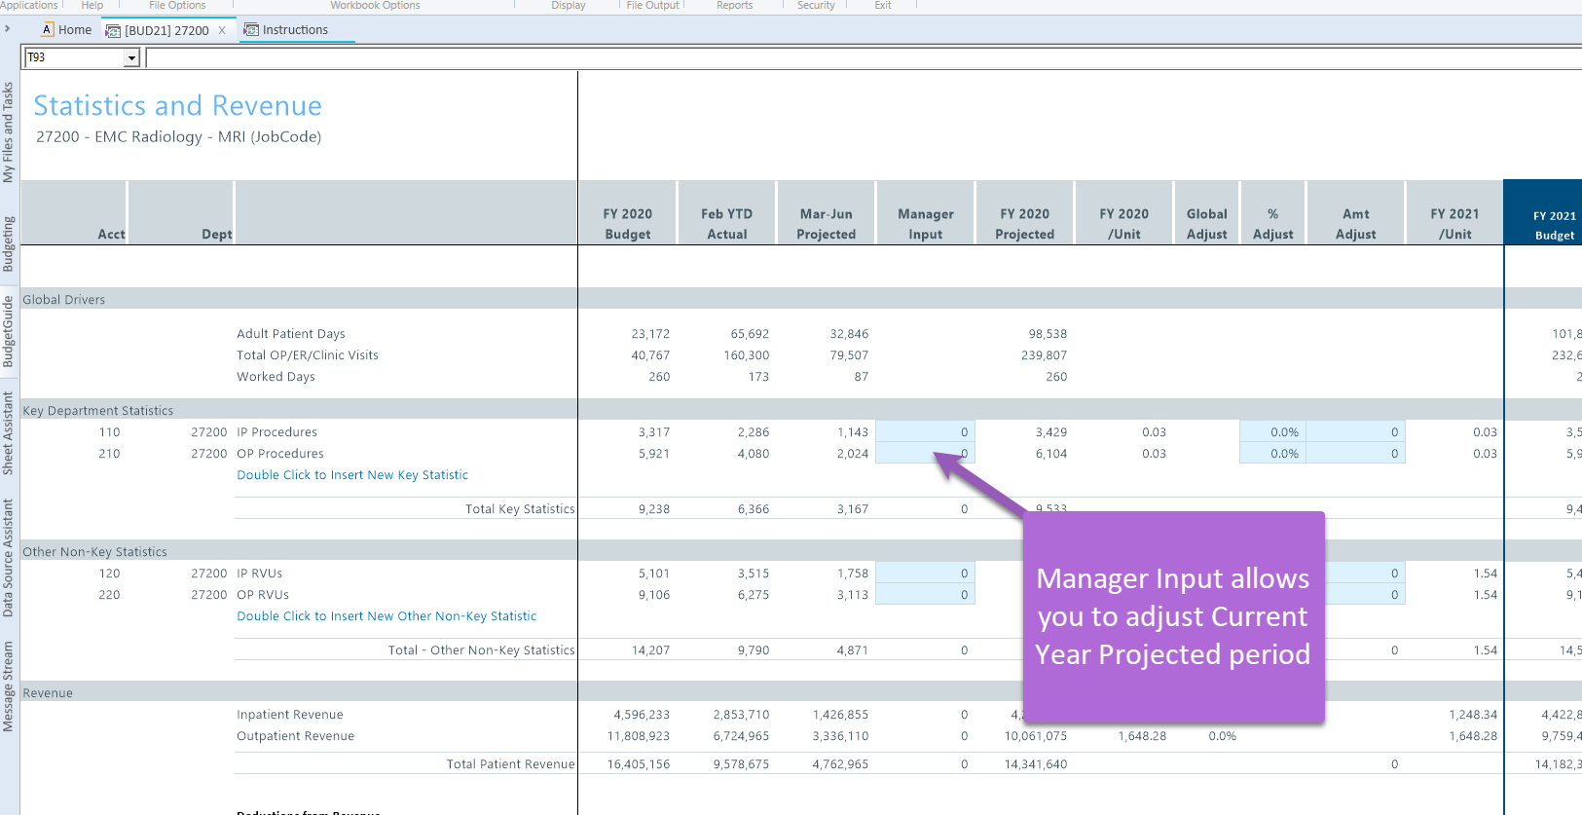
Lesson 2: Budget Process Overview
Stat_Rev Tab
Stat_Rev Tab:
  Budget your department statistics, patient revenue, other revenue and deductions at a department level.
  Historical data interfaces into this tab. Current run rates plus any global increases and assigned calculation methods (CM or Budget Methods) create your budget.
  Blue and green cells are areas where you can adjust data in the plan file.

Slide 27
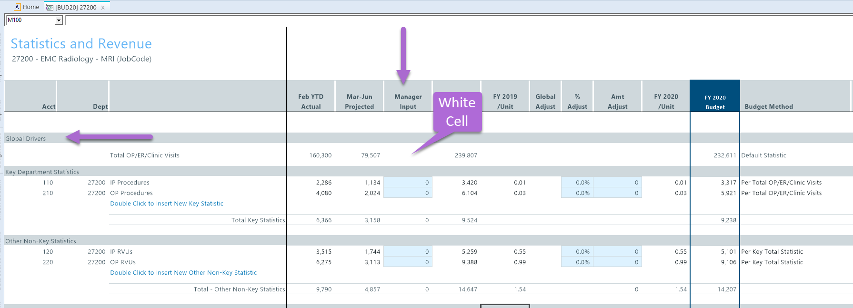
Lesson 2: Budget Process Overview
Stat_Rev Tab
  Global Drivers are entity level statistics (patient days, discharges, calendar days) that are used to temper your key department statistics.
  Note: Global Drivers are managed by your Administrator. You will not be able to adjust the Global Drivers.

Slide 28
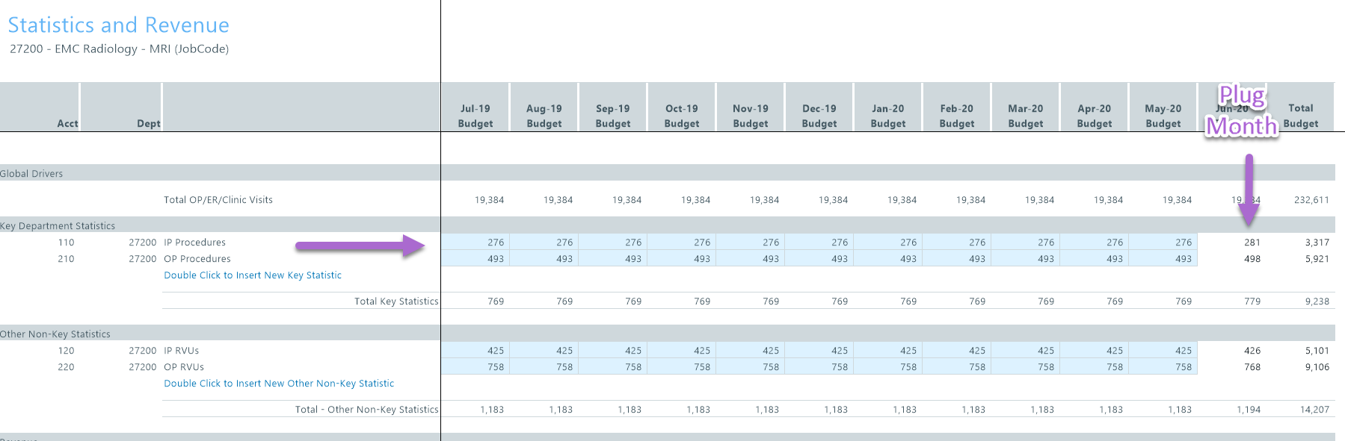
Lesson 2: Budget Process Overview
Stat_Rev Tab
  Depending upon your Administrator setup, you may or may not be able to adjust your monthly statistics. If the cells are blue, you can make monthly adjustments.
  Note: The final month of the budget year will be a plug, so make sure there are no negatives in the last month.

Slide 29
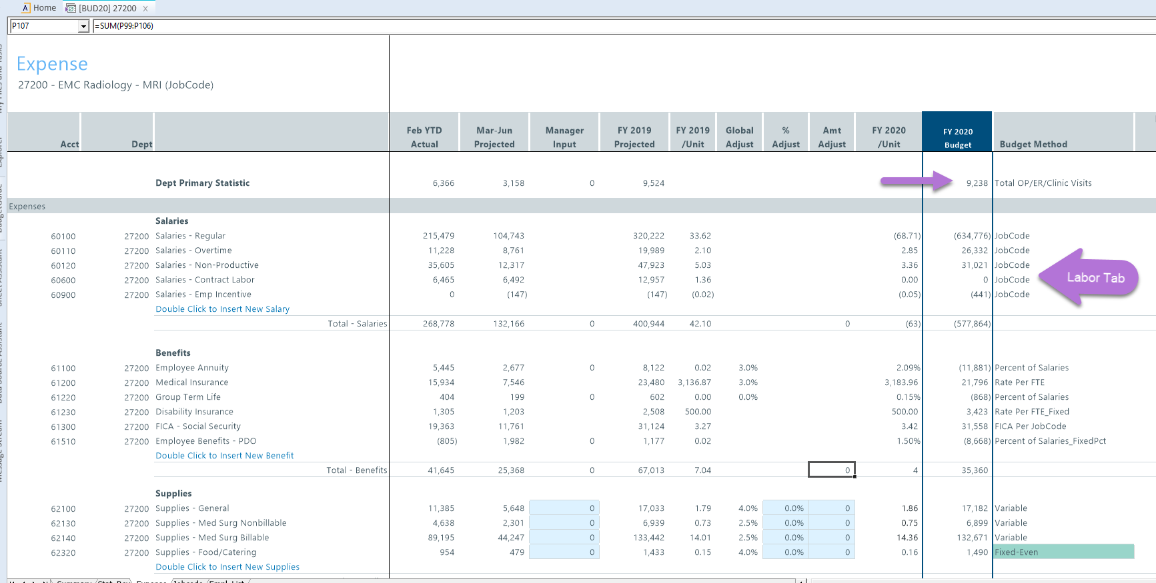
Lesson 2: Budget Process Overview
Expense Tab
  Expense tab is where you budget all your department expenses, except salaries.
  Salary calculations come from the Labor tabs (JobCode, Staffing, Employee).
  Variable expenses are driven by total Key Statistics.

Slide 30
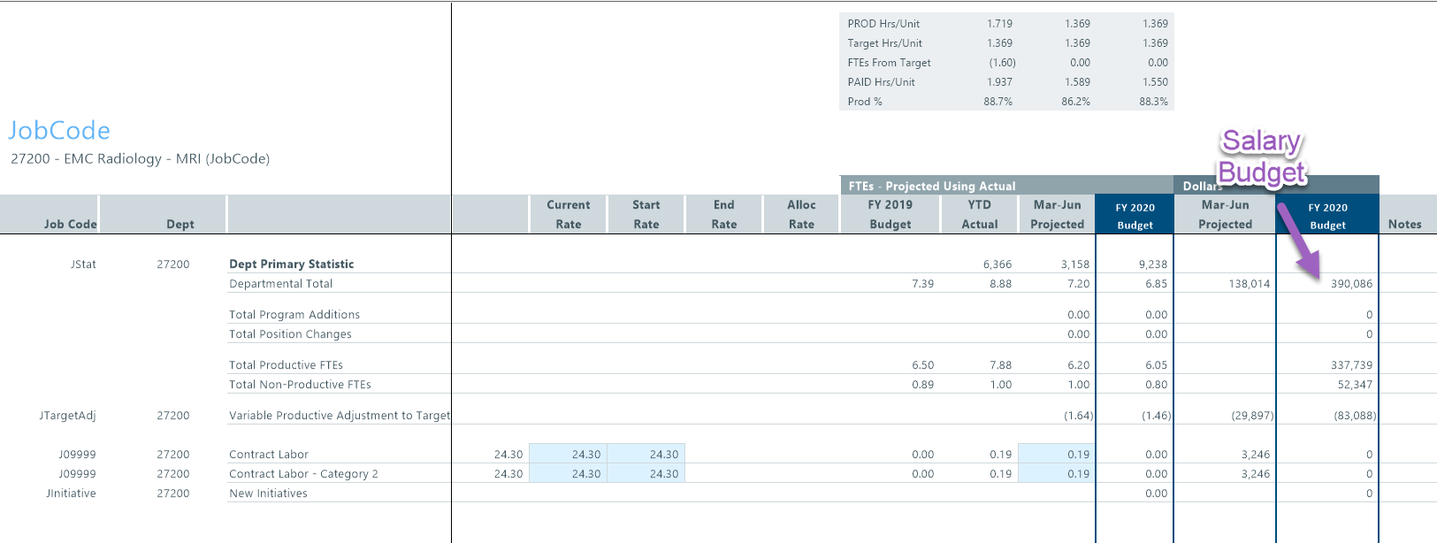
Lesson 2: Budget Process Overview
Labor Tab: One example JobCode tab
  JobCode tab is where you can budget salaries.
  Total Key Statistics are used to drive all variable expenses.

Slide 31
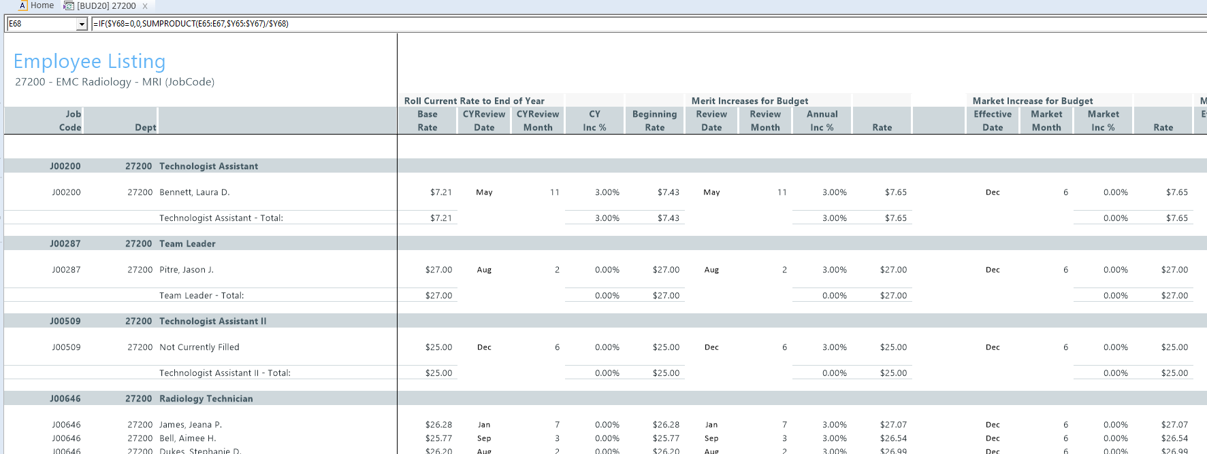
Lesson 2: Budget Process Overview
Empl_List Tab
  This tab is reference for the JobCode tab.
  Note: No work is done here.

Slide 32
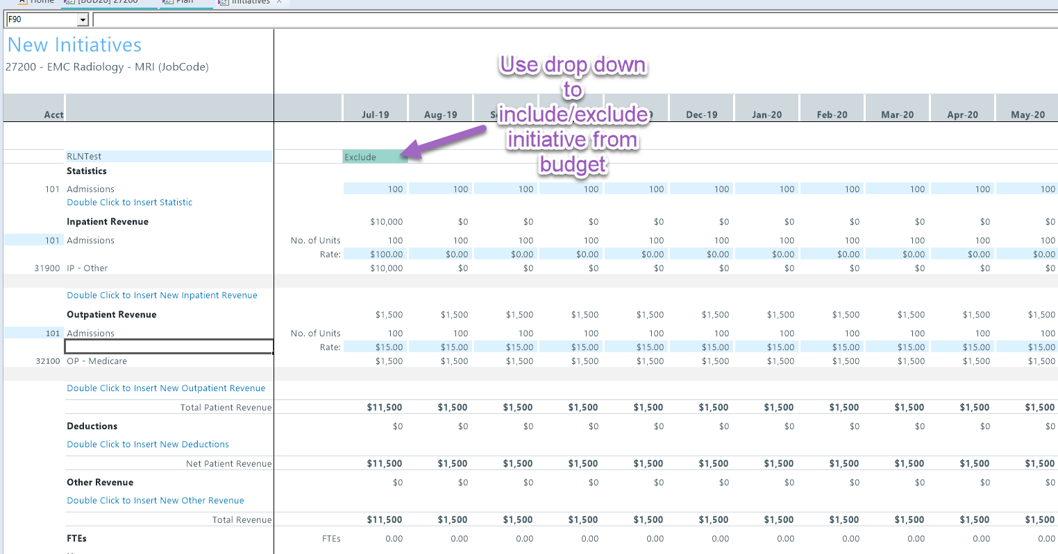
Lesson 2: Budget Process Overview
Initiatives Tab
  The Initiatives tab can be used to layer on strategic initiatives.
  Once built into the plan file, you can easily include or exclude the initiative utilizing the drop-down option.
  Multiple initiatives can be added to your department plan file.

Slide 33
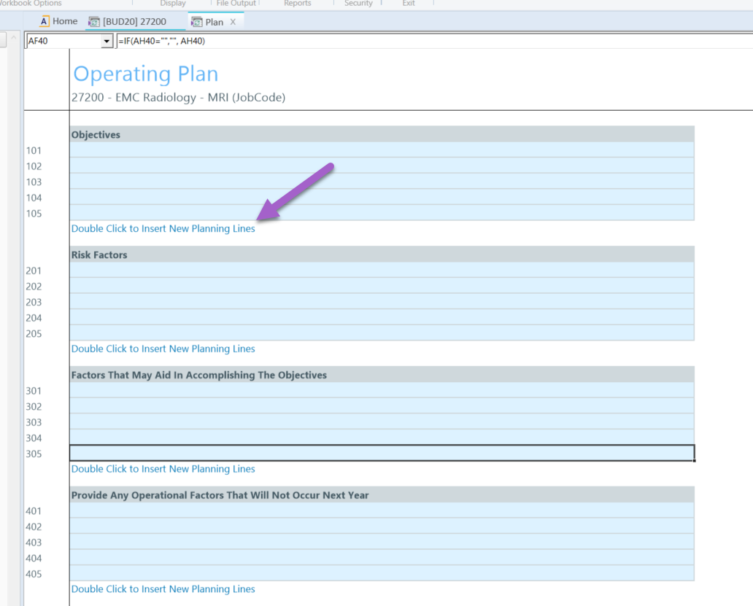
Lesson 2: Budget Process Overview
Operating Plan Tab
  The Operating Plan tab is an optional tab that is turned off or on by your Administrator.
  It is the story behind the numbers in your departmental budget.
    Keeps priorities in mind
    Explains reasons for changes to reviewers/directors
  The questions are populated by your Budget Administrator based upon guidance from your Finance Team.
  You can add lines as needed to answer the questions.

Slide 34
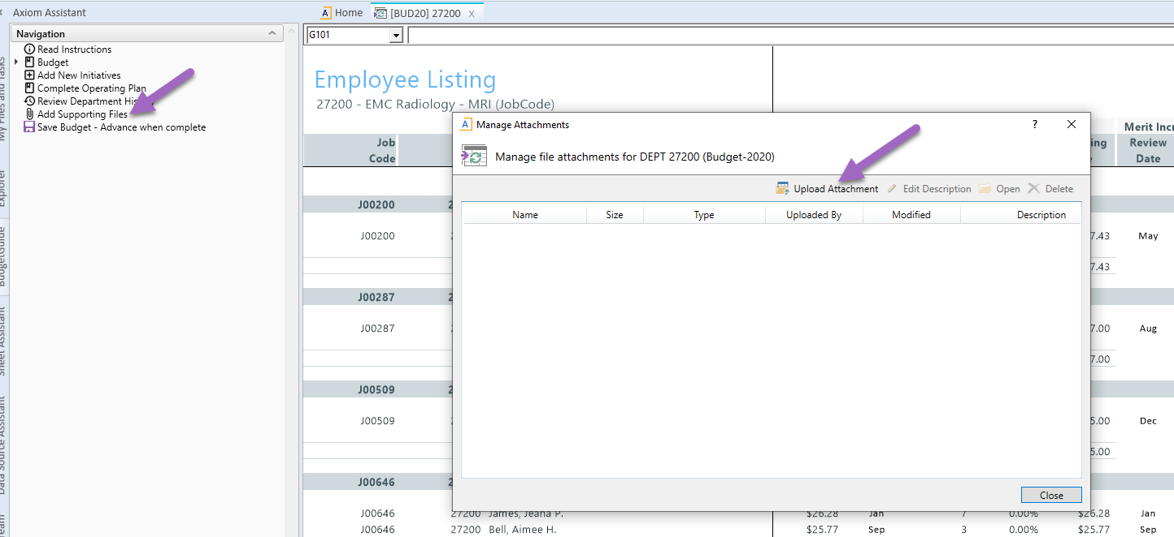
Lesson 2: Budget Process Overview
Add Supporting Files
  Upload supporting documents using Add Supporting Files in the Budget Guide.
  Navigate and select the to the source file from your PC.
  Be sure the file name and description provides a clear purpose.

Slide 35
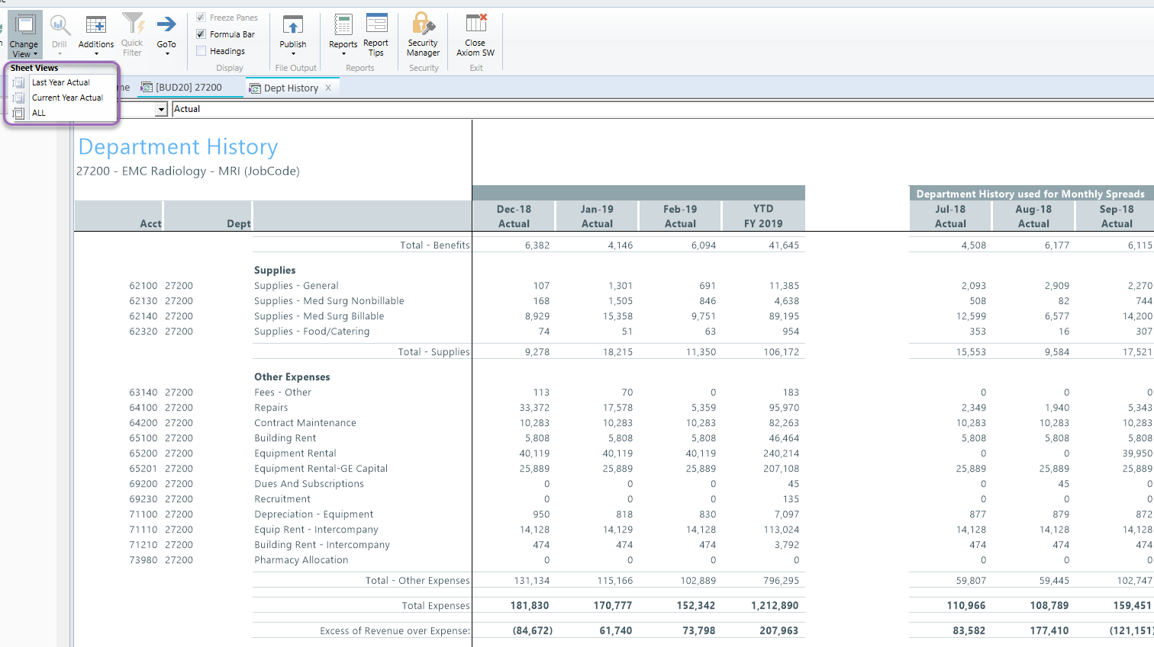
Lesson 2: Budget Process Overview
Dept_History Tab
  Reference tab that provides historical data for the last year and current year.
  It also has a view that displays the Rolling 12 month use for that spread methodology calculation.
  Helpful tool to see what spread methodologies may be best, especially for expenses.
    Does an expense hit in specific months?
    Are certain expenses accrued and should be fixed-even?

Slide 36
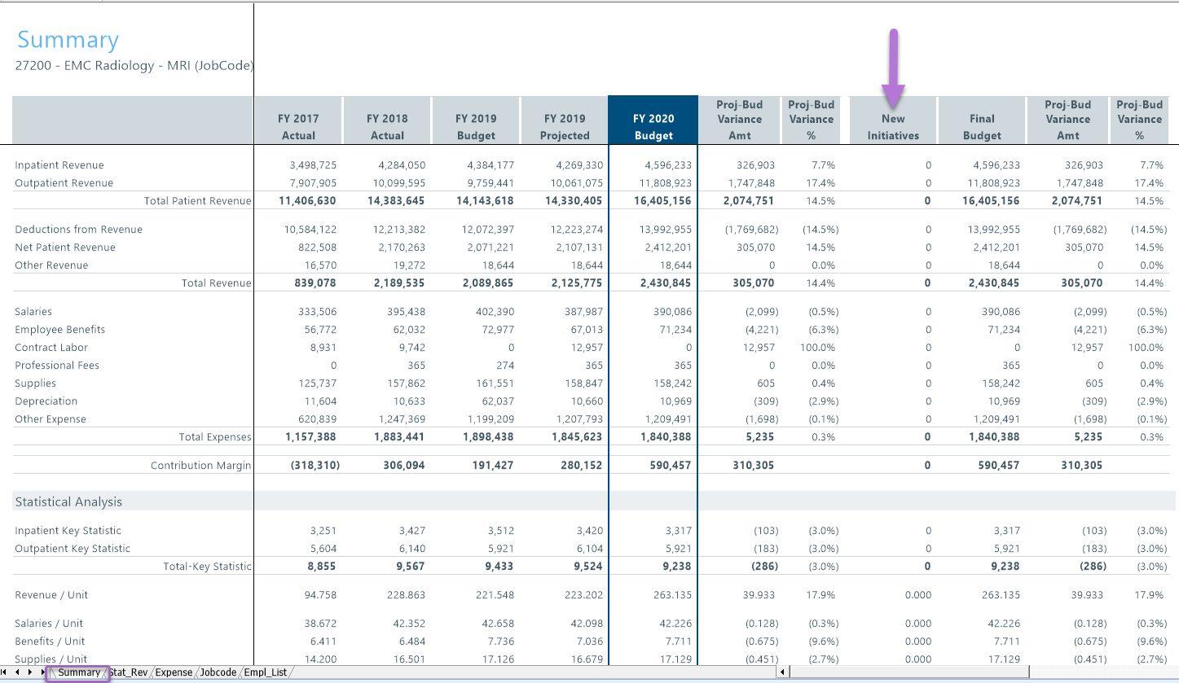
Lesson 2: Budget Process Overview
Summary Tab
  Last step: Review your results in the Summary tab
  Data is pulled into this tab from the other tabs; thus, it cannot be edited.
  It is “best practice” to review this tab for variance analysis and to ensure you did not miss any categories.
  Adjustments must be made on the other tabs in the plan file (Stat_Rev, Expense, JobCode, & Initiatives)

Slide 37
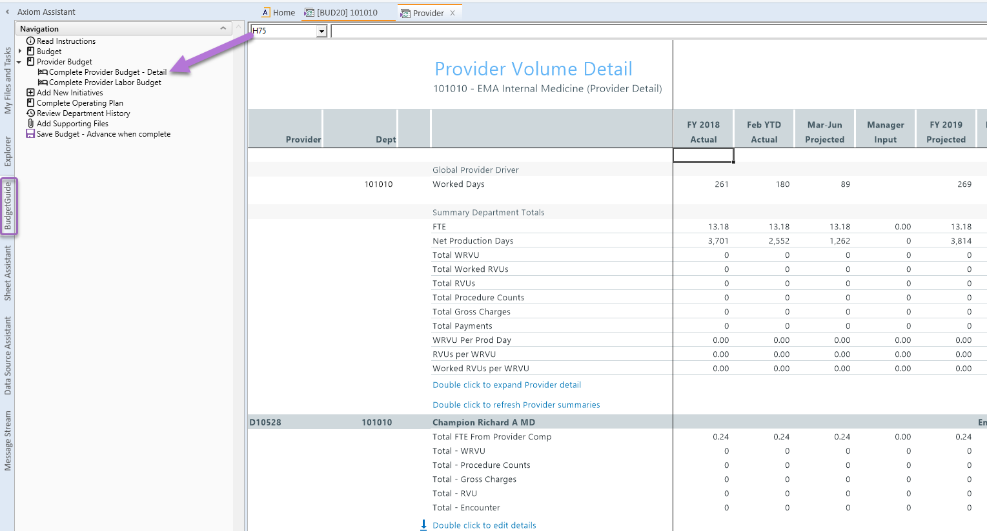
Lesson 2: Budget Process Overview
Provider Tab
  Use the Budget Guide to navigate to the Provider Budget tab.

Slide 38
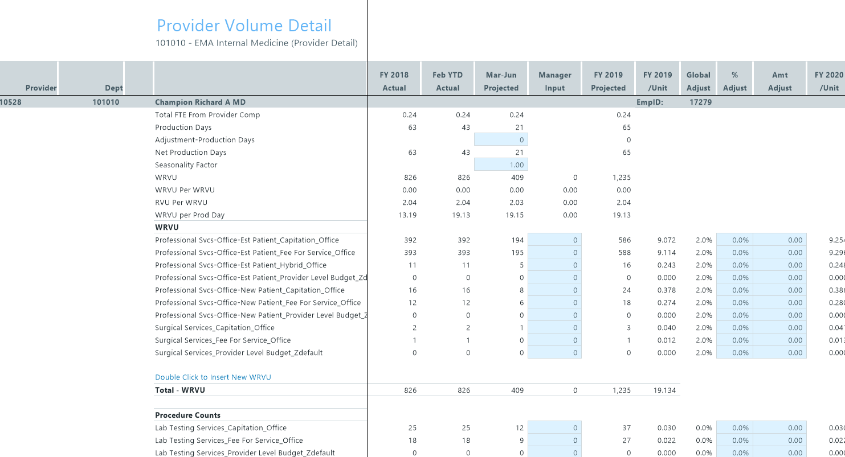
Lesson 2: Budget Process Overview
Provider Tab
  The Provider tab allows you to budget volumes and charges by provider.

Slide 39
Lesson 2: Budget Process Overview
Check List
  Make manager adjustments
  Review Current Year Projection
  Verify/edit all blue cells
  Review Next Year Budget values – total and monthly spreads
  Explain any changes by adding a comment on each line adjusted
  Review Summary tab for variance analysis
  Publish (if necessary) and save your adjustments

Slide 40
Lesson 2: Budget Process Overview
Review Questions
  What tab houses the Revenue & Statistics?
  What tab do I use to work on FTEs and Payroll?

Slide 41
Lesson 2: Budget Process Overview
Review Questions
  What is the purpose of the Detail Calc Method?

Slide 42
Lesson 2: Budget Process Overview
Review Questions
  What kind of expenses can we adjust on the Expense worksheet?

Slide 43
Lesson 2: Budget Process Overview
Review Questions
  What does a red flag (O) mean?

Slide 44
Lesson 2: Budget Process Overview
Recap
You should now be able to:
  Understand the purpose of each tab in a budget workbook
  Understand the time series that interface into the plan files
  Understand the Budget Methods assigned to a revenue or expense account

Slide 45
Lesson 2: Budget Process Overview

Slide 46
Working with Budgets
Lesson 3

Slide 47
Lesson 3 Objectives
By the end of this lesson, you should be able to:
  Enter adjustments
  Apply spread methodologies
  Enter detail accounts
  Complete payroll worksheet
  Budget for new initiatives

Slide 48
Lesson 3: Working with Budgets
Worksheets

Slide 49
Lesson 3: Working with Budgets
Review Questions
  What are spread options for fixed methodology?

Slide 50
Lesson 3: Working with Budgets
Review Questions
  [JobCode] What is the difference between program additions and program changes?
  [Staffing] What type of department should use the Staffing template?
  [ADC] What type of department should use the ADC template?
  [Employee] Can job codes be variable on the Employee tab?

Slide 51
Lesson 3: Working with Budgets
Recap
You should now be able to:
  Enter adjustments
  Apply spread methodologies
  Enter detail accounts
  Complete Labor tabs

Slide 52
Lesson 3: Working with Budgets

Slide 53
Review and Submit
Lesson 4

Slide 54
Lesson 4 Objectives
By the end of this lesson, you should be able to:
  Review your budget for completeness and consistency using the Summary tab
  Advance and return budgets through Process Management

Slide 55
Lesson 4: Review & Submit
Summary Worksheet

Slide 56
Lesson 4: Review & Submit
Review Questions
  How are the values in the “Final Budget” column different than the “FY (YYYY) Budget” column?

Slide 57
Lesson 4: Review & Submit
Review Questions
  Can changes be made to budgets after they are forwarded to the next approval level in Process Management?

Slide 58
Lesson 4: Review & Submit
Review Questions
  What should you do if you encounter an error during the save process?

Slide 59
Lesson 4: Review & Submit
Recap
You should now be able to:
  Review your budget for completeness and consistency using the Summary tab
  Advance and return budgets through Process Management

Slide 60
Lesson 4: Review & Submit

Slide 61
Printing Budgets
Lesson 5

Slide 62
Lesson 4: Review & Submit
Printing Budgets

Slide 63
Lesson 5: Printing Budgets
Recap
You should now be able to:
  Print your budget

Slide 64
Lesson 5: Printing Budgets

Slide 65
Wrap Up

Slide 66
Syntellis Budget User Training
Course Objectives
You should be able to:
  Log in to Axiom Budgeting
  Complete each tab in your budget plan file
  Save, print, and submit budgets for approval

Slide 67
Axiom Budgeting User Training
Presented by:
[place client name/logo here]
Client City, Stat
00/00/00

Slide 68
Thank you!
Client logo

